Slide 1
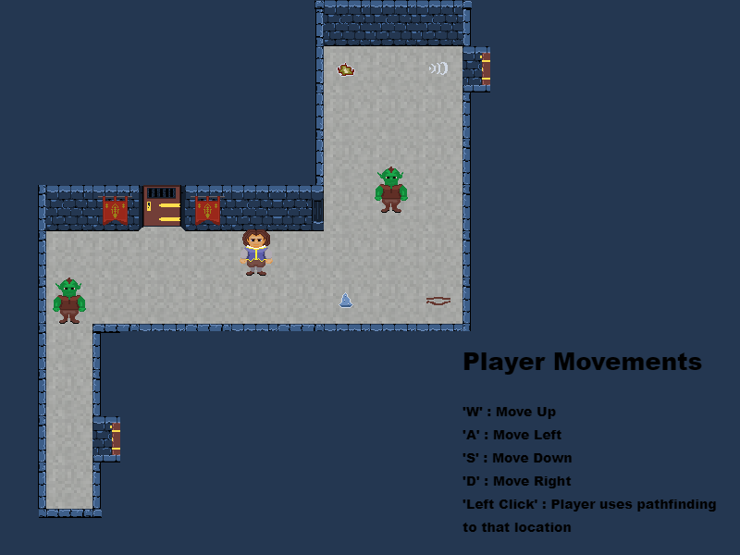
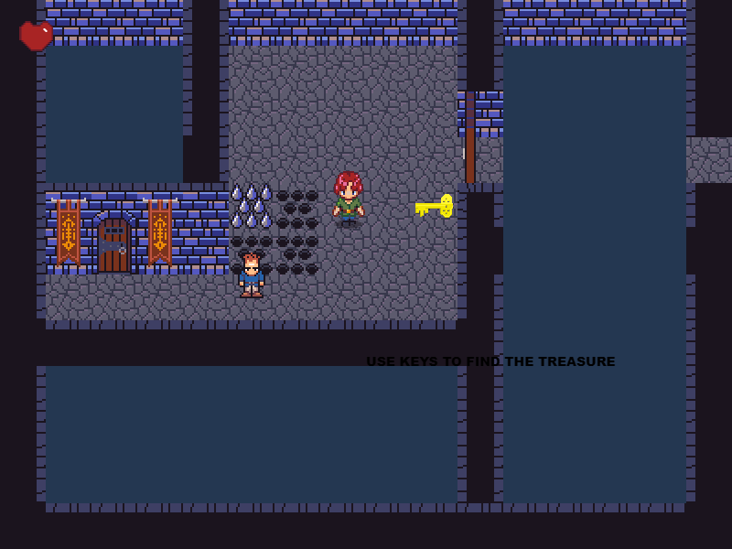
Dagger’s Gate
Pitch Date: 1/31/2021 Today: 2/7/2021 7:30 AM EST
Release Date: 5/23/2021
Team Lead: Vince McKeown 55 Commits

Slide 2
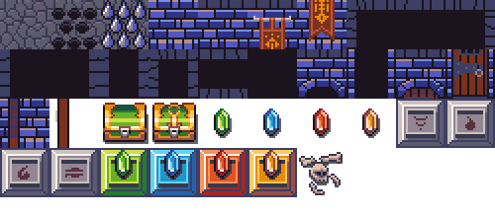

Contributors this week: Kyle Knutson
Tile Editor, and added new features
Created the Color Palette
Developed the Pixel Art Style (25 by 25) then stretched to (50 by 50)
Added Custom Text to Graphics Common
Created Dungeon Sprite Sheet

Slide 3
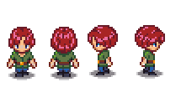
Contributors this week: Tylor Allison
Added Asset System, Property Tables, Sketch Code, Sprite Sheet
Code Cleanup
Added Level Class
Support code for interacting with double space Tiles
Added Player Sprite
Updated Collision Code
Fixed Heart display
Added Animation Class

Slide 4

Contributors this week: Vince McKeown
Pathfinding modification
Player can interact with objects
Player can open treasure chests and added player’s gold
Code Cleanup

